Slide 1
Multiple Linear Regression

Slide 2
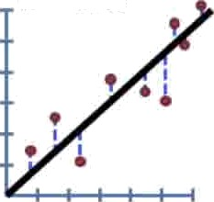
y= 0.1 + 0.78x
But the concept applies to any equation, no matter hDW Complicated.
R' ——60%
y = 0.1 + 0.78x - 8.3z + ....

Slide 3


But the concept applies to any equation, no matter how complicated.
y ——0.1 + 0.78x
R' = 60%
y —— 0.1 + 0.78x - 8.3z +
1) Measure, square and sum the distance from the data to the mean.
SS(mean) — SS(fit) SS(mean)

Slide 4




But the concept applies to any equation, no matter how complicated.
y = 0.1 + 0.78x
R“ = 60%
y = 0.1 + 0.78x - 8.3z +
Measure, square and sum the distance from the data to the mean.
Measure, square and sum the distance from the data
to the complicated equation.
SS(mean) — SS(fit)
SS(mean)

Slide 5
Let's look at slightly more complicated example:

Slide 6
Let's look at slightly more complicated example:
Imagine we wanted to know if mouse weight and tail length did a good job predicting the length of the mouse's body.

Slide 7

Let's look at slightly more complicated example:
Imagine we wanted to know if mouse weight and tail length did a good job predicting the length of the mouse's body.
Weight | Tail Length | Body Length
3.S | 2.9 | 3.1
1.3 | 2.1 | 2.8
5.9 | 4.1 | 6.1
4.8 | 3.2 | 3.8
So we measured bunch of mice...

Slide 8
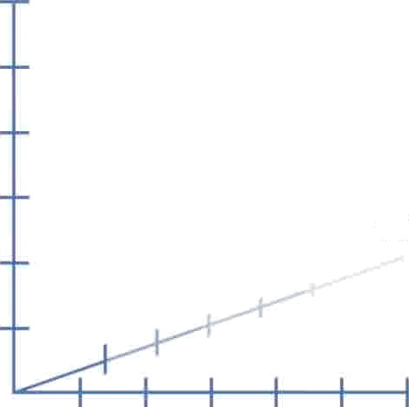
To plot this data, we need a 3-dimensional graph.
Body length
Tail length
Weight

Slide 9
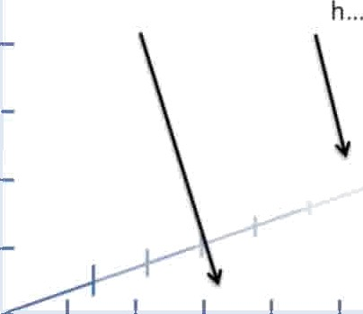
To plot this data, we need a 3-dimensional graph.
We want to know how well weight and tail lengt
Body length
Tail length
Weight

Slide 10


To plot this data, we need a 3-dimensional graph.
We want to know how well weight and tail length...
...predict body length.
-
Body length
Tail length
Weight

Slide 11
The first mouse we measured had...
Body length
Tail length
Mouse weight

Slide 12
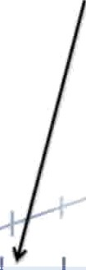

The first mouse we measured had...
""
Weight = 2.1
Body length
Tail length
Mouse weight

Slide 13


The first mouse we measured had...
""
Weight = 2.1 Tail length = 1.3
_
Body length
Tail length
Mouse weight

Slide 14


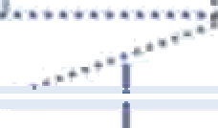
""
The first mouse we measured had...
Weight = 2.1 Tail length = 1.3 Body length = 2.5
Body length
Tail length
Mouse weight

Slide 15
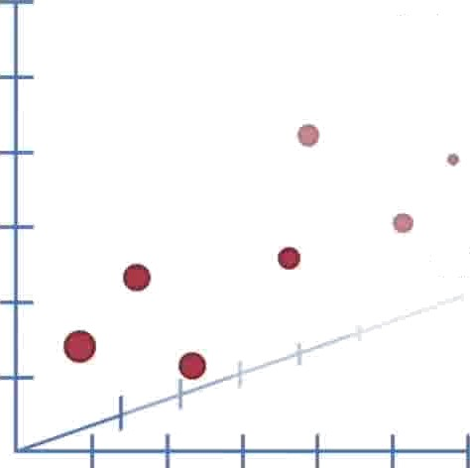
Here's all the data in the graph.
Body length
Tail length
Mouse weight

Slide 16
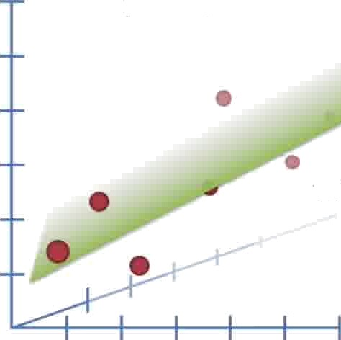
Now we do a least-squares fit. Since we have the extra term in the equation, we fit a plane instead of a line.
Body length
Tail length
Mouse weight

Slide 17

Now we do a least-squares fit. Since we have the extra term in the equation, we fit a plane instead of a line.
y = 0.1 + 0.7x + 0.5z
Body length
Tail length
Mouse weight

Slide 18
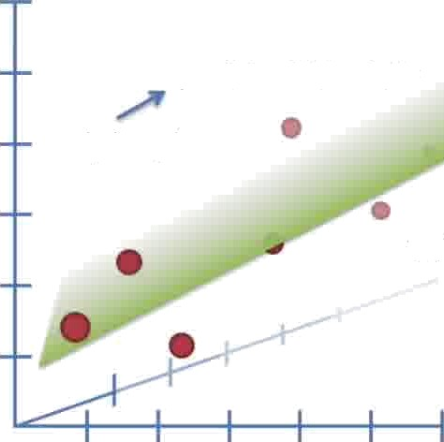
y = 0.1 + 0.7x + 0.5z
Body length
Body length
Tail length
Mouse weight

Slide 19
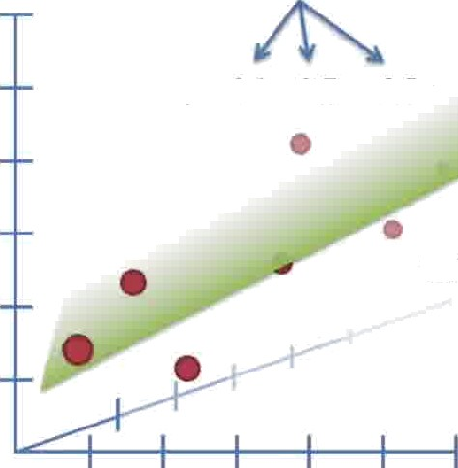
Least-squares estimates 3 parameters...
y ——0.1 + 0.7x + 0 5z
Body length
Tail length
Mouse weight

Slide 20
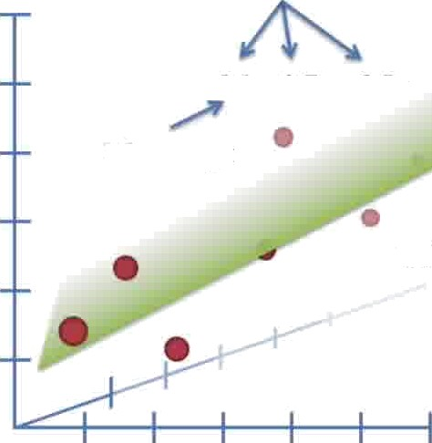
Least-squares estimates 3 parameters...
y ——0.1 + 0.7x + 0.5z
Y intercept
Body length
Tail length
Mouse weight

Slide 21
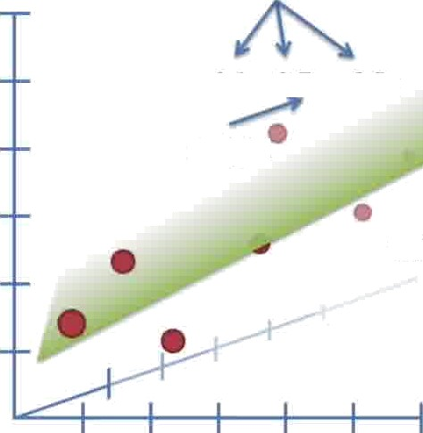
Least-squares estimates 3 parameter5...
y ——0.1 + 0.7x + 0.5z
Weight
Body length
Tail length
Mouse weight

Slide 22
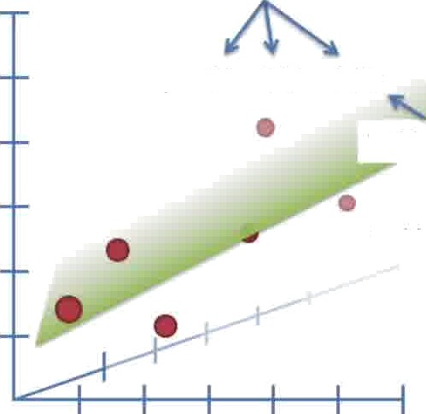
Least-squares estimates 3 parameters...
y ——0.1 + 0.7x + 0.5z
Tail length
Body length
Tail length
Mouse weight

Slide 23

If we know a mouse's weight and tail length, we can use the equation to guess the body length.
y ——0.1 + 0.7x + 0 5z
Body length
Tail length
Mouse weight

Slide 24
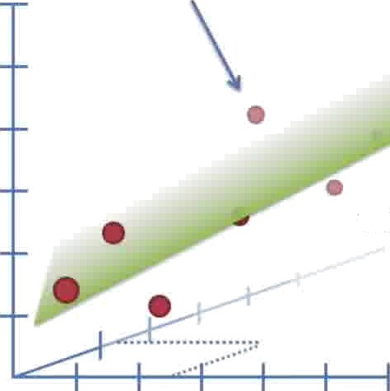
For example, given the weight and tail length for this mouse...
Body length
Tail length
Mouse weight

Slide 25
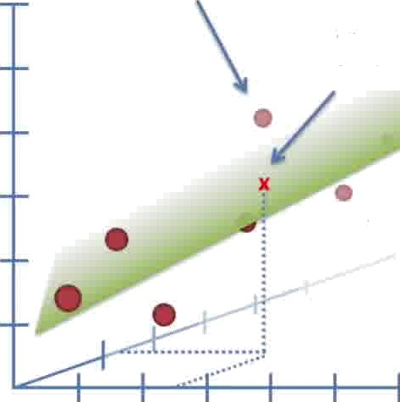
For example, given the weight and tail length for this mouse...
The equation predicts this body length.
Body length
Tail length
Mouse weight

Slide 26
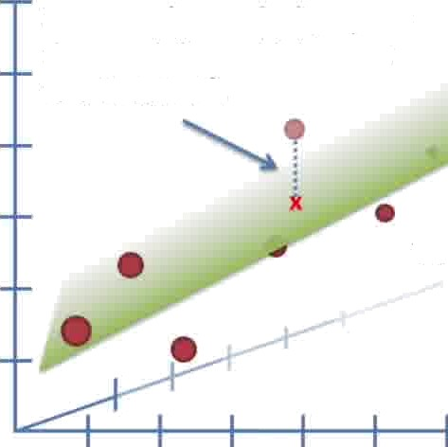
Just like before, we can measure the residuals, square them and then add them up to calculate R².
Body length
Tail length
Mouse weight

Slide 27
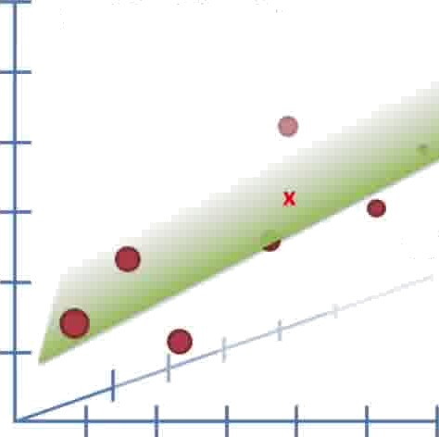
Now, if the tail length (z-axis) is u5ele5s and doesn't make SS(fit) smaller, then least- squares will ignore it by making that parameter = 0.
y = 0.1 + 0.7x + 0z
Body length
Tail length
Mouse weight

Slide 28
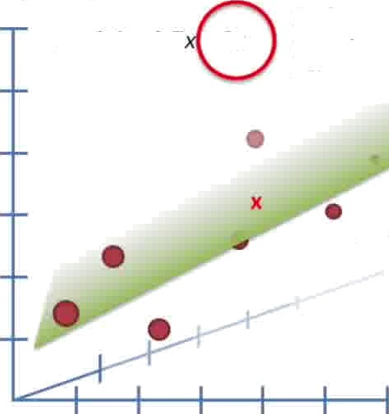
Now, if the tail length (z-axis) is usele5s and doesn't make SS(fit) smaller, then Iea5t- squares will ignore it by making that parameter = 0.
In this case, plugging the tail length
y = 0.1 + 0*7 OF
into the equation would have no effect on predicting the mouse size.
Body length
Tail length
Mouse weight

Slide 29
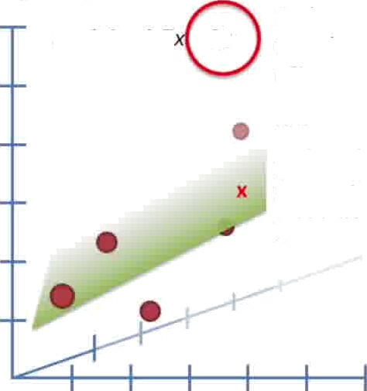
Now, if the tail length (z-axis) is useless and doesn't make SS(fit) smaller, then least- squares will ignore it by making that parameter = 0.
In this case, plugging the tail length
y = 0.1 + 0.7 ’+ Oz
into the equation would have no effect on predicting the mouse size.
This means equatiDns with more parameters will never make SS(fit) worse than equations with fewer parameters.
Body length
Mouse weight

Slide 30
Multiple Linear RegressionIn
Multiple Linear Regression (MLR), we model the relationship between two or more independent variables (predictors) and one dependent variable (target). The general form of the equation is:
Y=b₀+b₁x₁+b₂X₂+⋯+bpXpY
Where:
Y is the dependent variable (target),
X₁,X₂,…,X_{p} are the independent variables (predictors),
b₀ is the intercept,
b₁,b₂,…,b_{p} are the coefficients of the predictors.

Slide 31
Let's use a simple example where we have two independent variables (X₁: number of hours studied, and X₂: number of hours slept) and one dependent
variable (Y: exam score).
Multiple Linear Regression Equation
The multiple linear regression equation for this case will be: Y=b₀+b₁X₁+b₂X₂Y
∑X₁ (sum of hours studied)
∑X₂ (sum of hours slept)
∑Y (sum of exam scores)
∑X₁² (sum of the square of hours studied)
∑X₂² (sum of the square of hours slept)
∑X₁X₂ (sum of the product of hours studied and hours slept)
∑X₁Y (sum of the product of hours studied and exam scores)
∑X₂Y (sum of the product of hours slept and exam scores)
X1 | X2 | Y
2 | 6 | 50
3 | 5 | 55
4 | 8 | 65
5 | 7 | 70
6 | 6 | 80

Slide 32
Let's use a simple example where we have two independent variables (X₁: number of hours studied, and X₂: number of hours slept) and one dependent
variable (Y: exam score).
Multiple Linear Regression Equation
The multiple linear regression equation for this case will be: Y=b₀+b₁X₁+b₂X₂Y
∑X₁ (sum of hours studied)
∑X₂ (sum of hours slept)
∑Y (sum of exam scores)
∑X₁² (sum of the square of hours studied)
∑X₂² (sum of the square of hours slept)
∑X₁X₂ (sum of the product of hours studied and hours slept)
∑X₁Y (sum of the product of hours studied and exam scores)
∑X₂Y (sum of the product of hours slept and exam scores)
X1 | X2 | Y
2 | 6 | 50
3 | 5 | 55
4 | 8 | 65
5 | 7 | 70
6 | 6 | 80

Slide 33
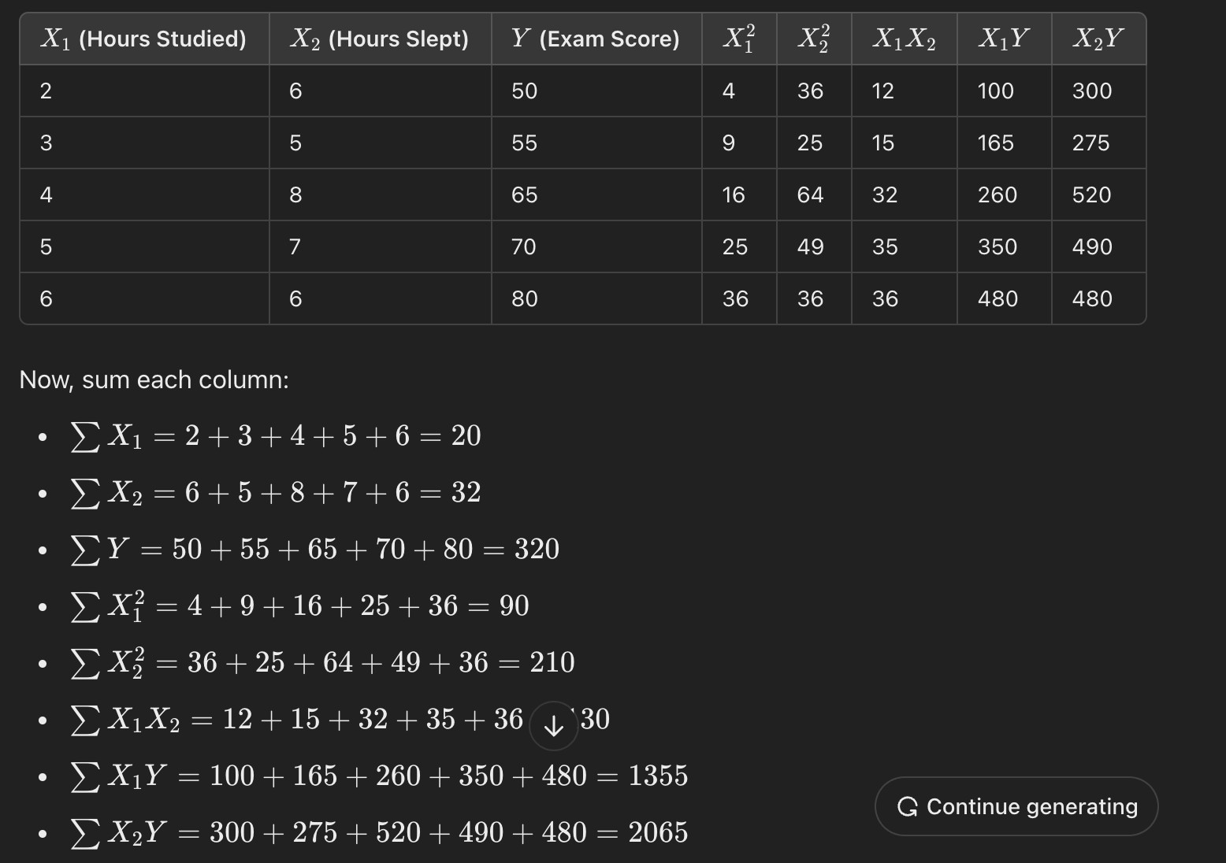

Slide 34
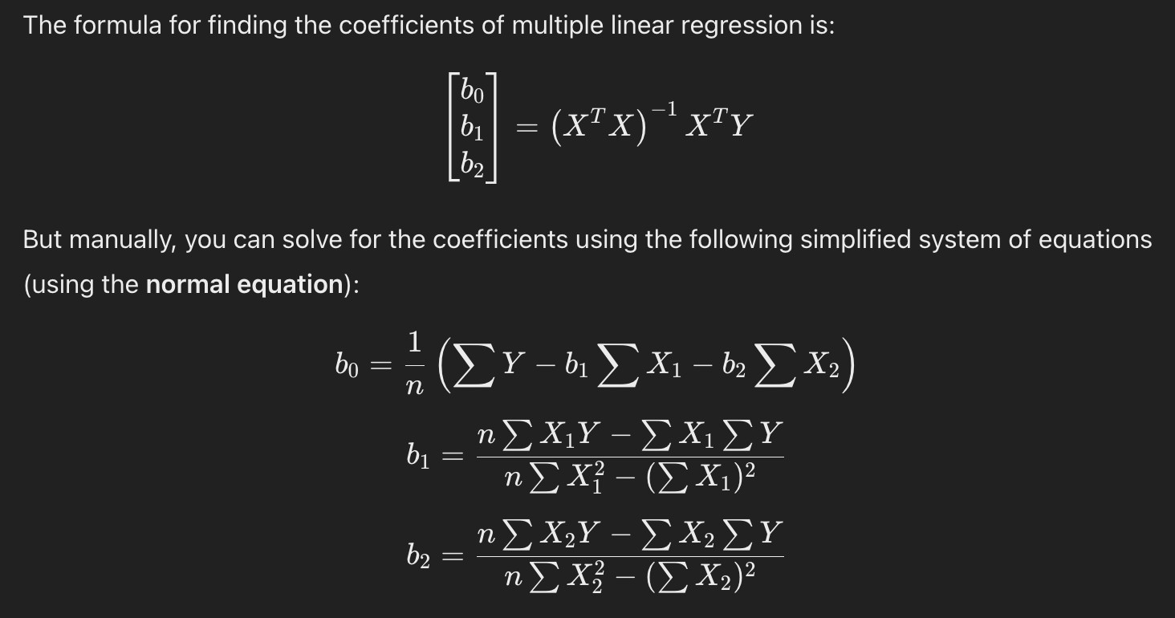

Slide 36
